Slide 1


Business Processes & Diagrams
Lin Yang
Meng Shao
Ben Carruth
Notes:
Hello wonderful people. In today’s meeting we will present the skills and knowledge the Business Analyst brings to a team. The presentation will be broken into two stages : Processes and Diagrams.

Slide 2
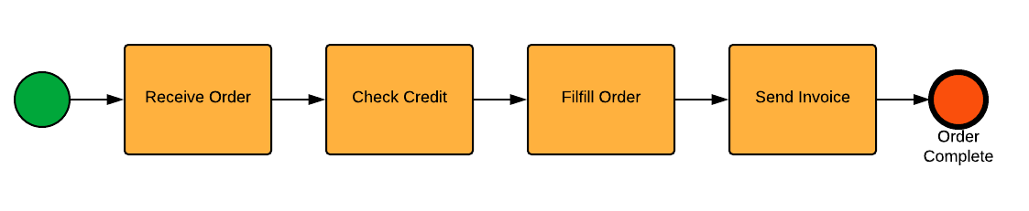
Introduction
Notes:
Designing and combining components building a system it’s essential to align business strategy with the available technology. This requires understanding the connection between high-level business capabilities and the detailed requirements necessary for software development.

Slide 3

Capabilities
Capabilities represent the high-level abilities needed to meet organizational goals.
Example: Customer Relationship Management (CRM)
Notes:
Capabilities are functions that businesses must excel at to achieve its core objectives. For example, the ability to manage customer relationships through email promotions or app notifications effectively is a capability.

Slide 4
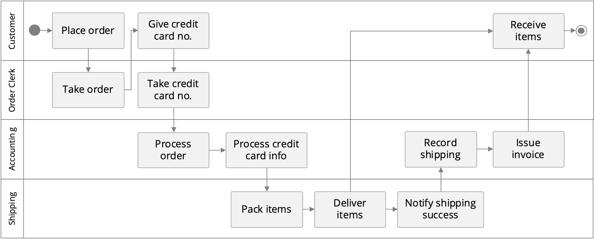
Business Processes
Processes break capabilities down into tasks.
Sales Process → Lead Management → Email Campaigns
Notes:
Business processes provide the structure and order to achieve capabilities. They describe the specific tasks that need to be done, like lead management and metadata collection process of a system.

Slide 5
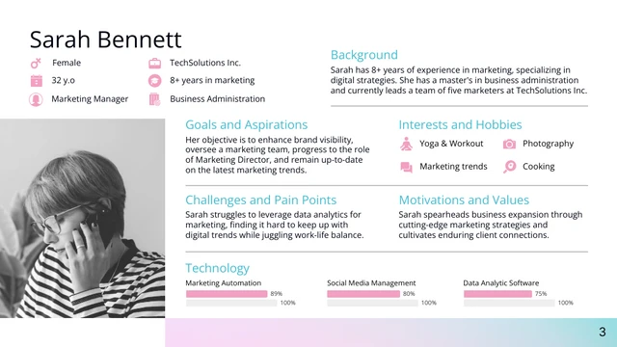
User Personas
Notes:
Personas are fictional users who will interact with the system. They include demographics, goals, and behaviors to guide design and development.
Example: Persona 1: John, a 35-year-old marketing manager who is tech-savvy and relies on data to drive marketing decisions.
He needs tools to easily visualize customer data for targeted campaigns.
Understanding personas ensures the product solves real problems for the target audience.

Slide 6
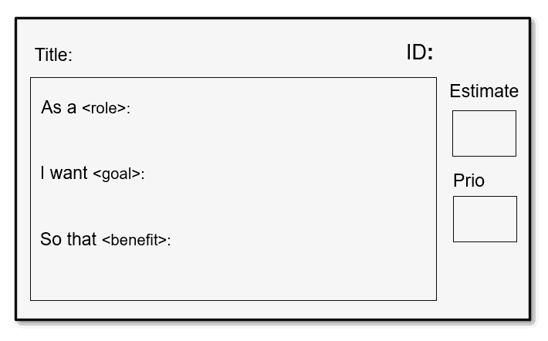
User Stories
User stories describe the needs of a user in simple terms.
Example: "As a marketing manager, I want to view real-time reports."
Notes:
User stories are created to define the needs of a user. They help translate business requirements into actionable tasks for the development team through creating a story.

Slide 7
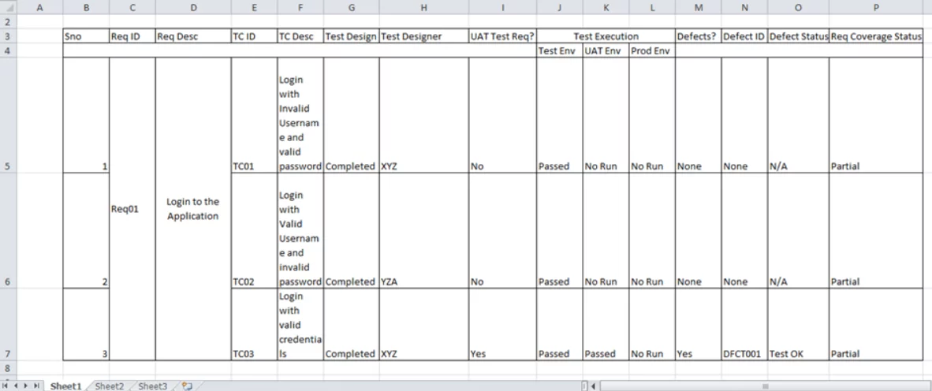
Requirements
Requirements specify the exact functionality needed.
Example: "Functional: System must allow segmentation by purchase history."
Notes:
Requirements describe in detail what the system needs to align with the user stories. These can be functional, such as filtering data, or non-functional, like system performance.

Slide 8
Connecting the Dots
Capabilities
Business Processes
Persona
User Story
Requirements
Notes:
All components are connected.
Capabilities drive processes, these need to align with user personas and stories.
Requirements translate these stories into technical specifications.

Slide 9
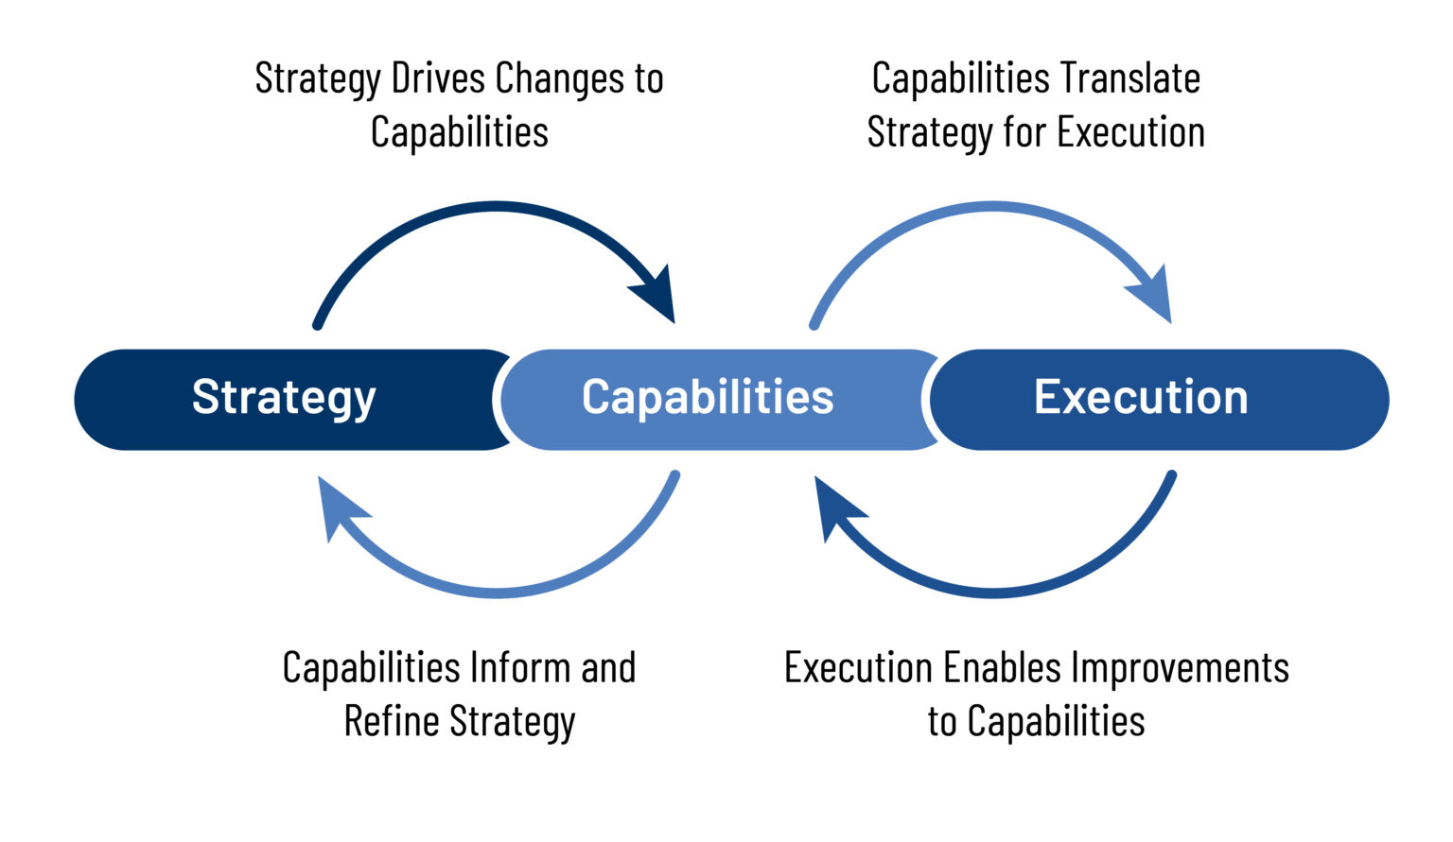
Alignment ensures successful project outcomes
Notes:
By aligning business capabilities, processes, personas, and requirements of any project is the key to its success. It ensures business needs are what the development team delivers.

Slide 10

Diagrams

Slide 11
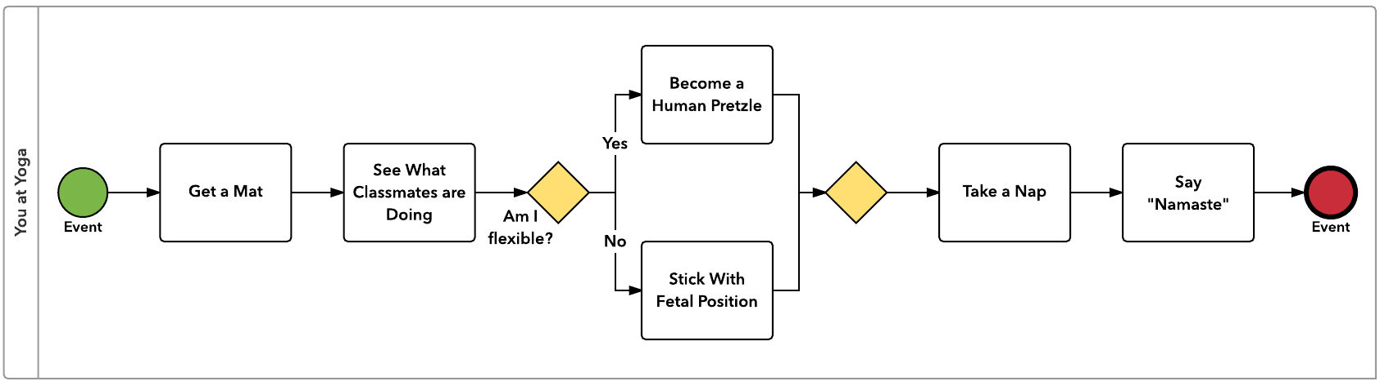
Business Process Model and Notation (BPMN) Diagram
Notes:
A Business Process Model and Notation diagram identifies points where tasks, decisions or events flow during a process. Each point is assigned a symbol or gateway.
Understanding how processes flow within a business, identifying bottlenecks, and optimizing efficiency helps us map out the business logic.

Slide 12
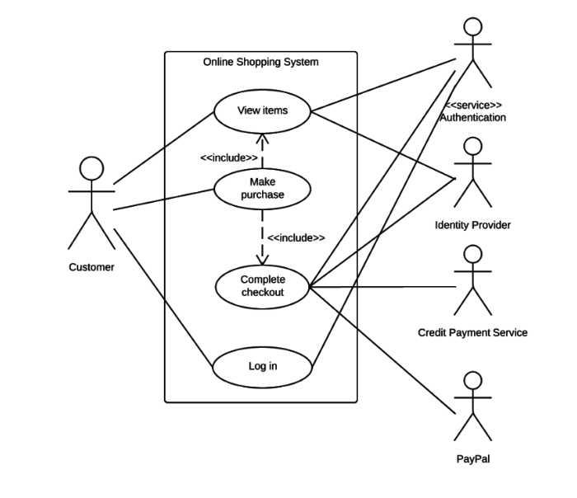
Use Case Diagram
Notes:
The use case diagram shows interactions between users and a system. It focus on the functions and features the system provides, and the user requirements.
This defines the scope of the system.
This example shows the connections between a user, a payment system and authentication.
This is essential in system design.

Slide 13
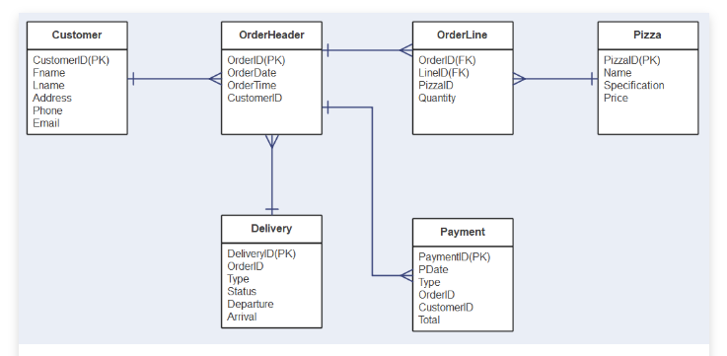
Entity-Relationship (ER) Diagram Example
Notes:
Specifically for database design, an ERD defines how each entity’s relationship is connected to the next. Independent and dependant components coalesce to demonstrate how, and if different data connects during the user's navigation through the system.

Slide 14
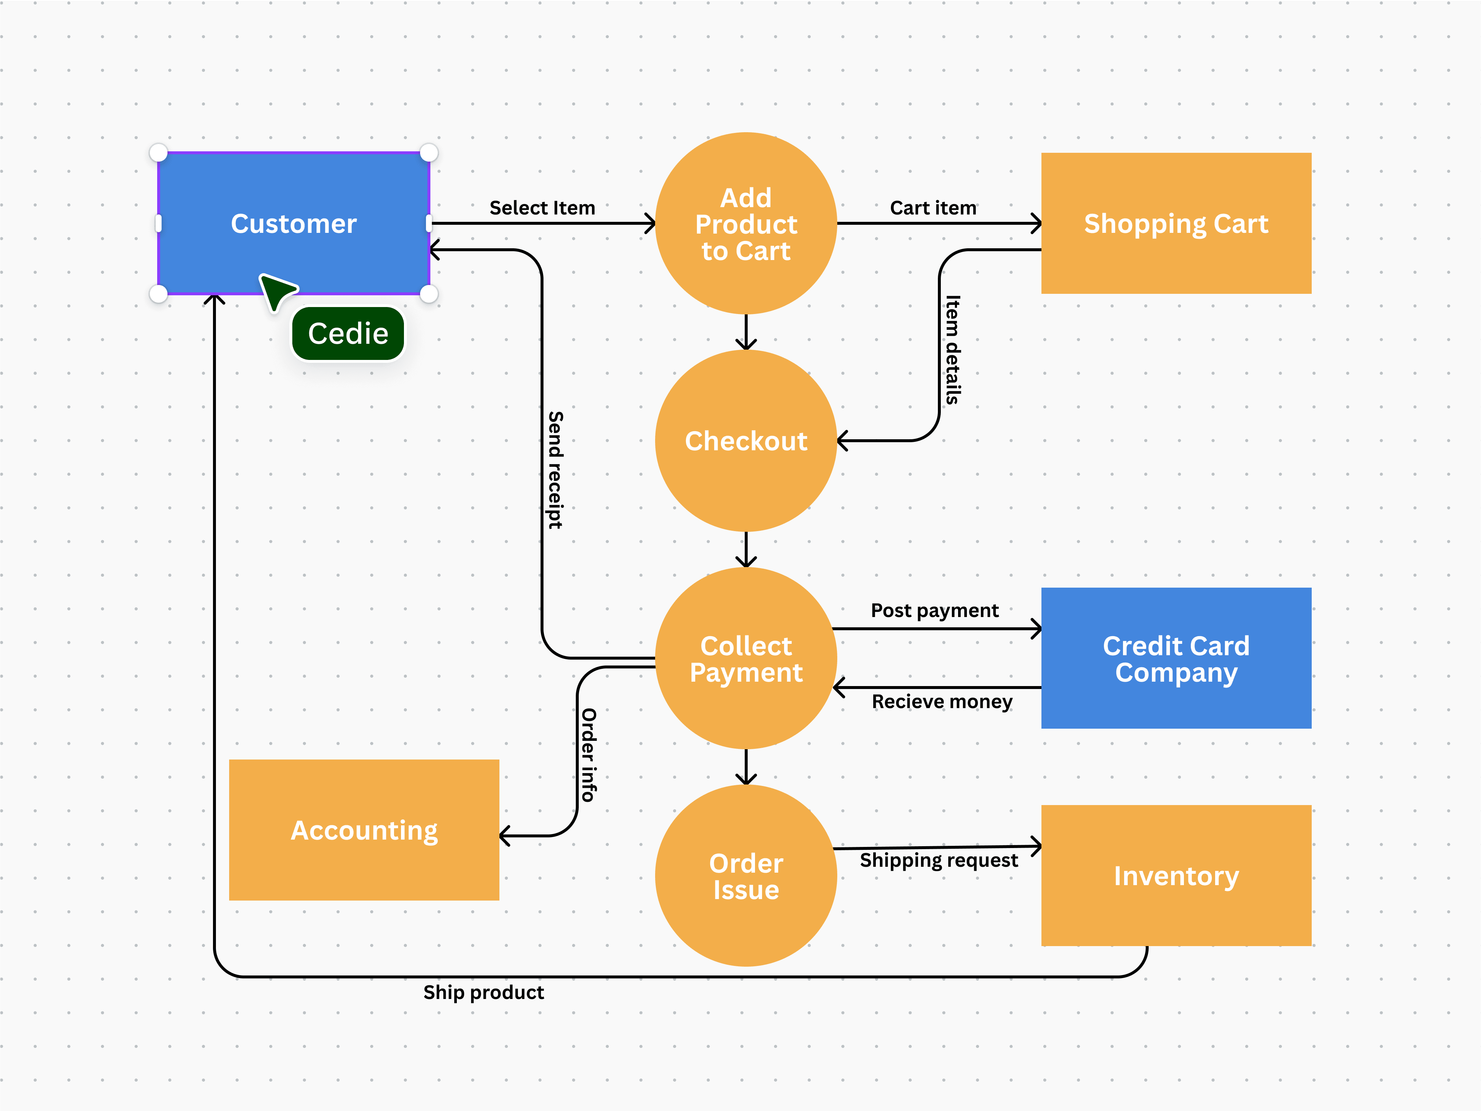
Data Flow Diagram
Notes:
In this DFD example, we can see how data moves between processes and data base. Here data flows from the entity 'Customer' to the 'Order Processing'.
It helps identify inputs, outputs, data storage, and the processes that transform data. This is essential for understanding the flow of information within a system.
This makes it easy to identify where data is stored and processed, and helps us understand the system's overall flow of information.

Slide 15
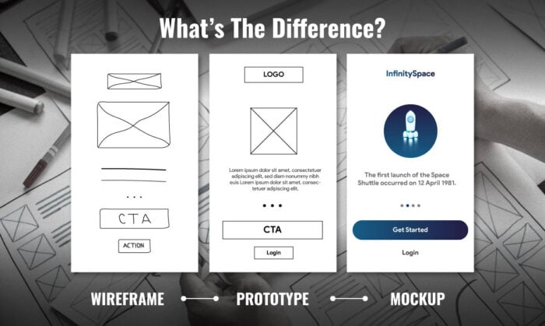
Wireframe or Mockup
Notes:
A wireframe provides a basic layout of a system or app, drawn to emphasize element placement. This moves to a prototype.
The prototype includes more detail, such as functional elements. The mock-up adds design aspects like colour schemes and text, offering a more realistic preview of the final product.

Slide 16
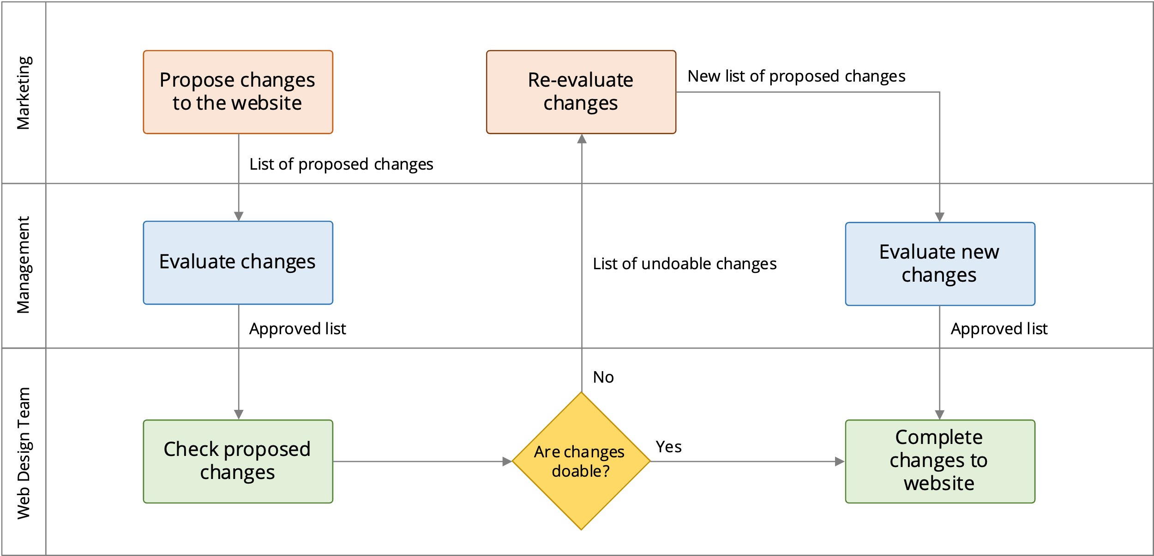
Swimlane Diagram
Notes:
The swim-lane diagram shows how tasks are divided between different departments, with each lane representing a different role such as marketing, management and web design. It helps clarify who is responsible for each part of the process, making it easier to identify handoffs and responsibilities.
This map shows task flow between different roles and lanes. It's useful for identifying inefficiencies or redundancies in multi-department processes.

Slide 17
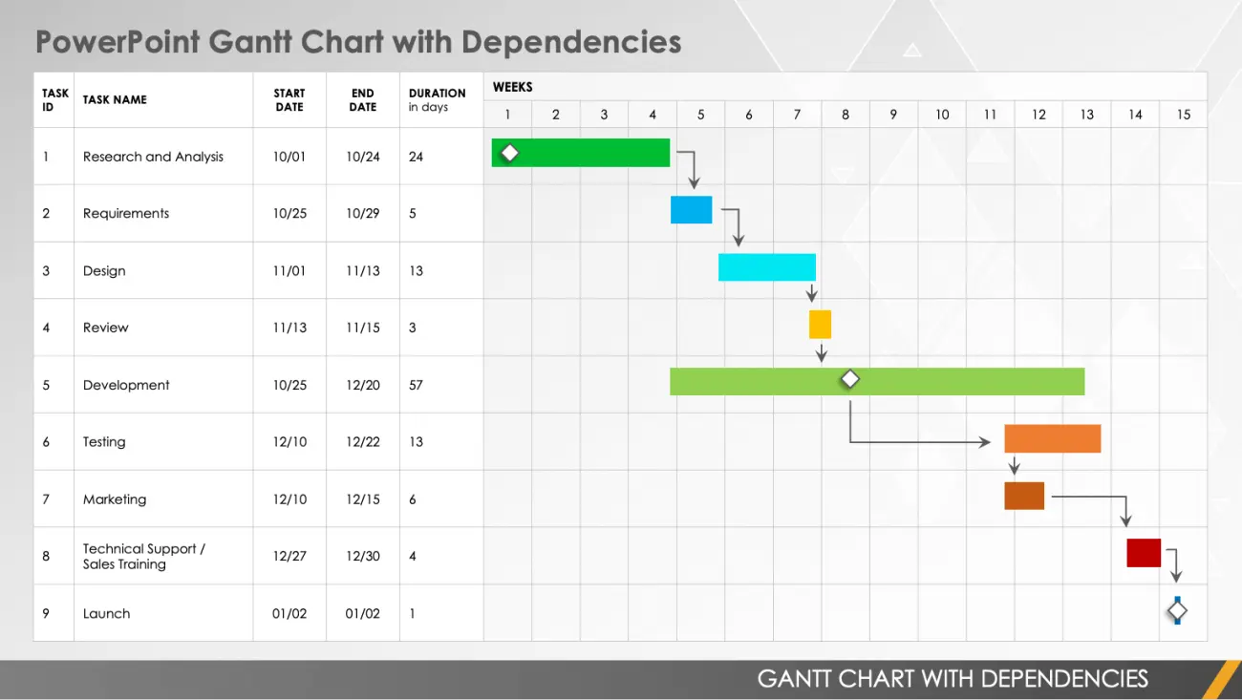
Gantt Chart
Notes:
In a Gantt Chart each task is represented as a bar showing its duration over time. By mapping the tasks and identifying which are dependent makes it easy to track the progress of tasks and ensure that deadlines are met by project managers by indicating the order of operations.

Slide 18
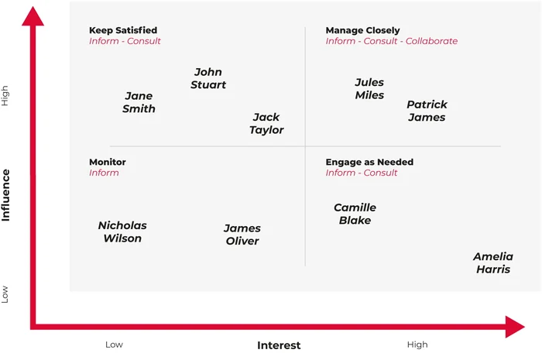
Stakeholder Map
Notes:
Stakeholders are categorized based on their level of decision power and interest in the project.
High-power, high-interest stakeholders are prioritized for frequent communication.
This map helps ensure that the right people are involved at the right stages of the project.
This is important for communication planning, ensuring that key players are informed and involved appropriately.

Slide 19
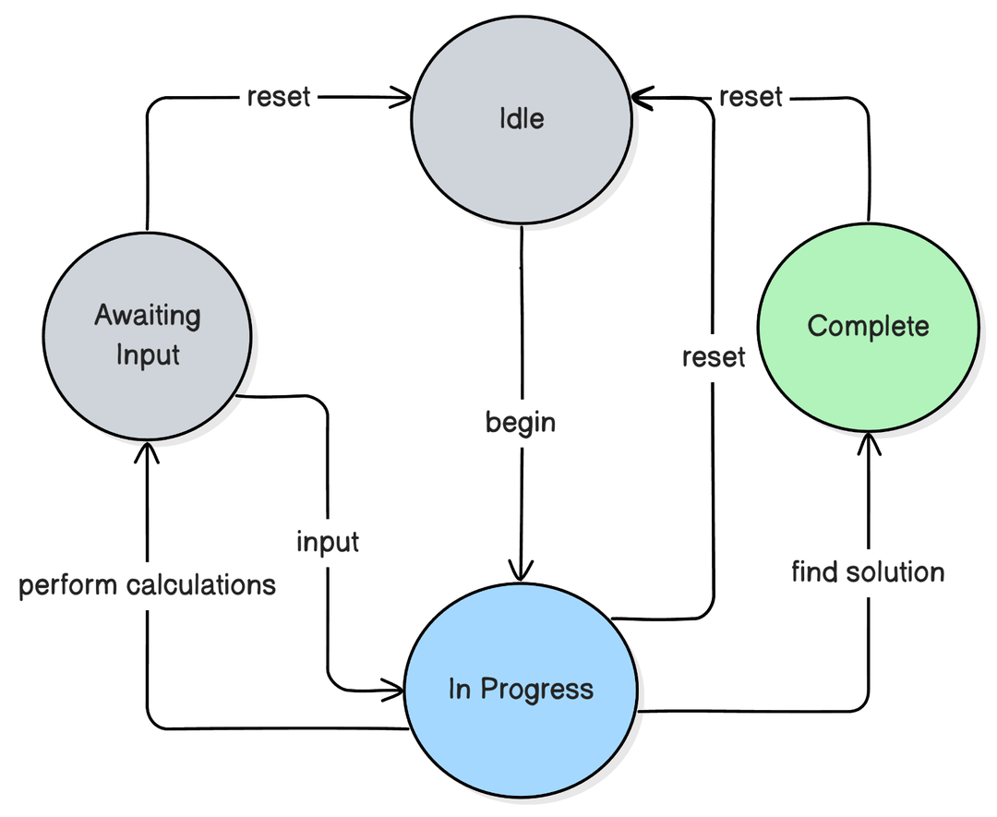
State Diagram
Notes:
The state diagram shows an object transitioning between states, such as ‘awaiting input’ to ‘complete’ based on different triggers within a system.
Each state and their transition when events occur are mapped. This is used to model the dynamic behaviour of systems and how they respond to different inputs.
It helps visualize state transitions, such as the lifecycle of an object.

Slide 20
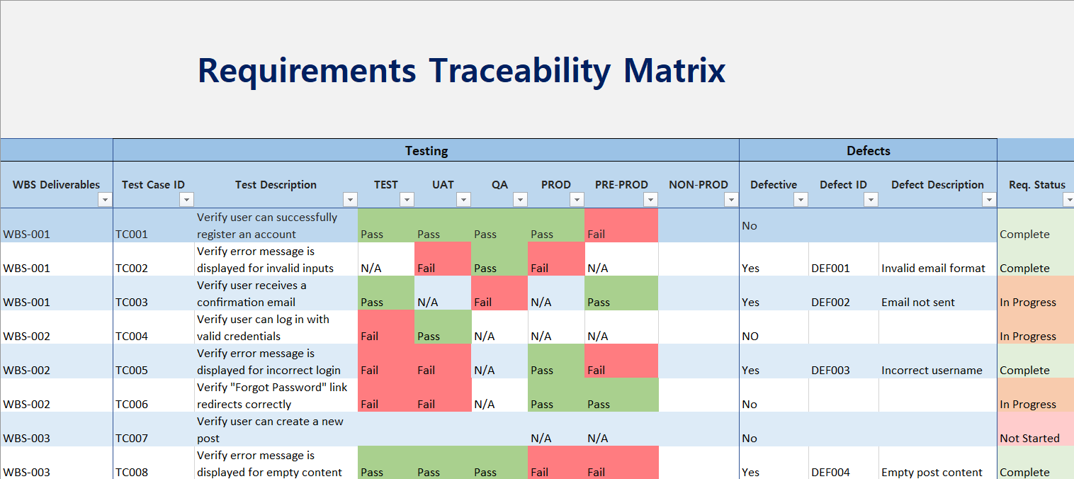
Requirement Traceability Matrix
Notes:
This RTM shows how user requirements are mapped to test cases, ensuring that each requirement is properly validated.
It's a useful tool for tracking progress and ensuring that no requirement is overlooked during testing.
The Matrix is a key tool for quality assurance and helps make sure nothing is overlooked and adequately tested before deployment.

Slide 21
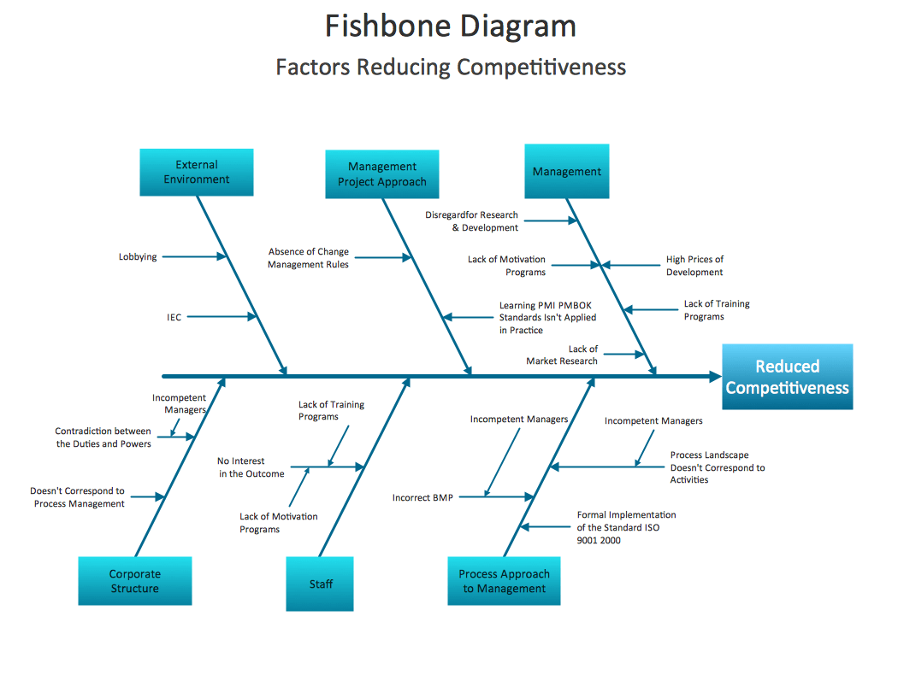
Gap Analysis Diagram
Notes:
The gap analysis compares the current state of a system with the desired future state. The diagram identifies key gaps that need to be addressed.
It highlights the specific areas where improvements are needed and helps plan the steps required to bridge the gap.
Mapping the gaps allow the business to prioritize tasks to bridge those gaps. This is a valuable tool for continuous improvement and strategic planning.

Slide 22
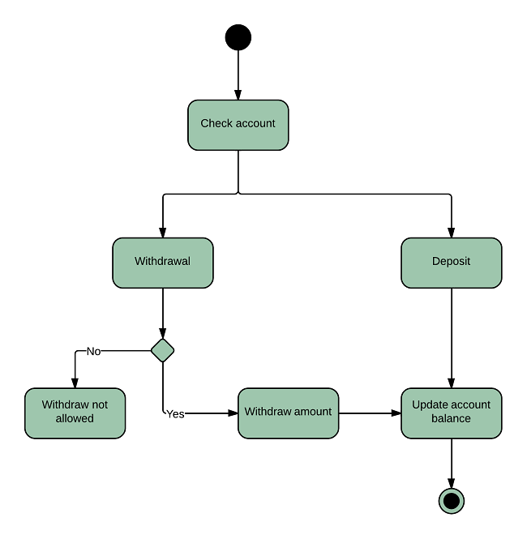
Activity Diagram
Notes:
This diagram helps clarify how a system performs certain activities and how the workflow progresses.
An activity diagram models the workflow of a system, showing how activities are performed and how control flows between them. It helps visualize complex processes and is useful for both software development and business process management. Each action in the diagram represents a step in the workflow, helping to see the big picture.

Slide 23

Questions?
Notes:
Thank you for your attention. Please feel free to ask any questions of our team.

